Slide 1
Module 3 Innovation-Documentation
Part 3

Slide 2
KNOW-HOW

Slide 3

Investment project "Novosibirsk Dolphinarium»

Slide 4

Analytical article

Slide 5
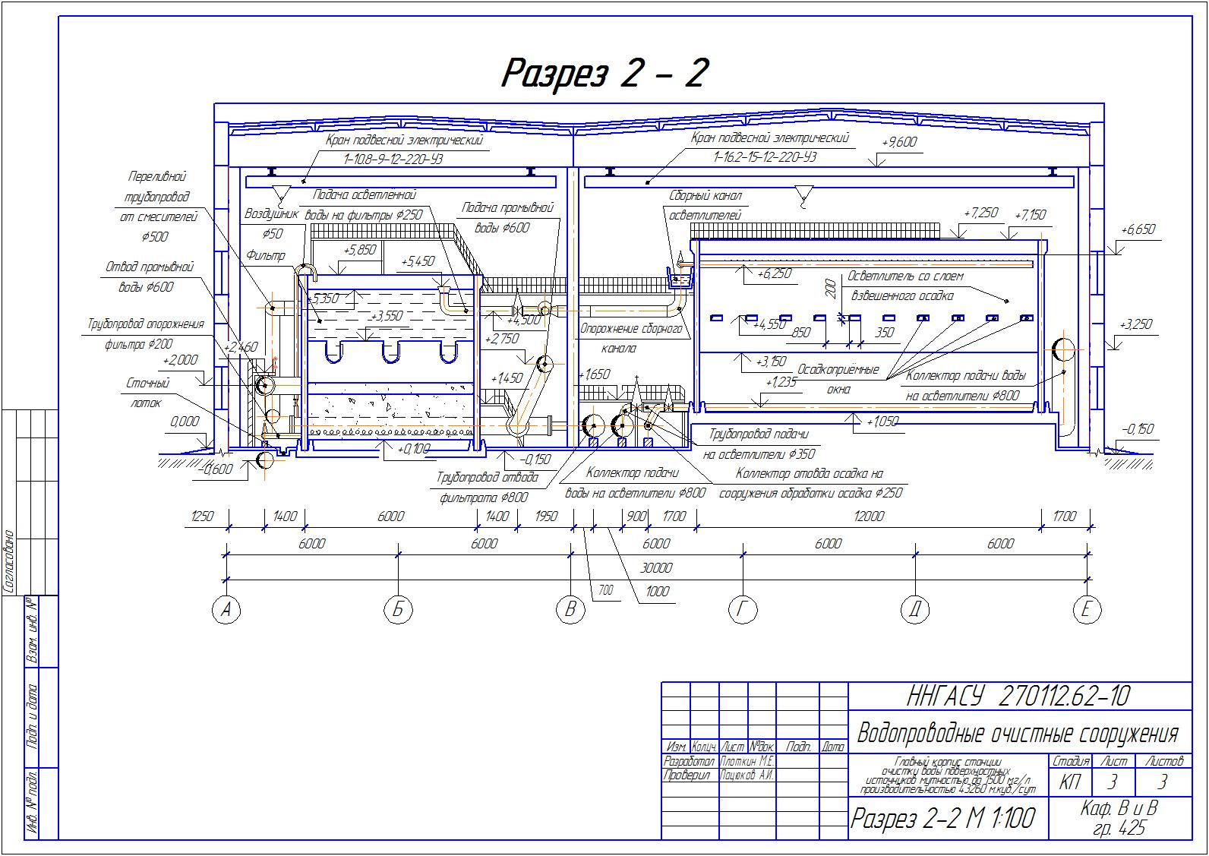
Construction drawing

Slide 6
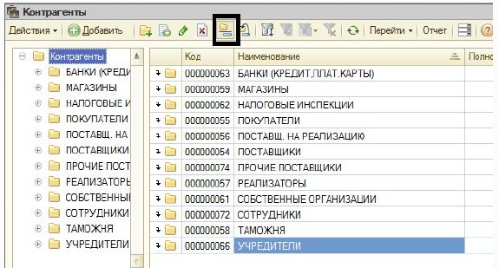
Construction drawing

Slide 7
Trips Convention (Article 39) - signs of know-how:
it is not generally known and easily accessible to persons in those circles who usually deal with such information,
because of the secrecy is of commercial value
is the object of appropriate steps in the circumstances, aimed at maintaining its secrecy on the part of the person lawfully controlling this information.

Slide 8

Stump about know-how
Structural drawings
Results of experiments and their protocols
The list of research works, common tables and results of calculations in their special application for the production of a certain product
Statistical calculation
Formulas and recipes
Data on the quality of the materials
Parts list
Herbert Stumpf " Agreement on transfer of Know-how»

Slide 9
Drawings of the supplied equipment, including processing instructions
Lists of norms that provide information about the results
Work plans with time and tolerances
Technology instructions (e.g. thermal regime requirements)
Drawings Manufacturing documentation
Reports on manufactured products
Optimal number of standard parts
Acceptance and test requirements
Construction reports, equipment lists

Slide 10
Quantitative calculations for outdoor installation
Data of programming works
Training of personnel of another company.
Client files File
Cabinet suppliers
Data on the organization of production
Documentation on programming in the commercial sphere
Documentation about the organization of marketing and distribution
Funding data
Advertising method
Training of commercial personnel other enterprise
the list is not complete……

Slide 11
FZ "ON COMMERCIAL SECRETS»
The Identity of the concepts of know-how and the secret of production (article 1)
Introduction of the additional concept:trade secret
- This is the confidentiality of information, allowing its owner to existing or possible circumstances to increase the income, avoid unnecessary costs, maintain the position in the market of goods, works, services or otherwise commercial benefit.

Slide 12

Что такое информация, составляющая коммерческую тайну (секрет производства)?
сведения любого характера (производственные, технические, экономические, организационные и другие), в том числе о результатах интеллектуальной деятельности в научно­-технической сфере, а также сведения о способах осуществления профессиональной деятельности, которые имеют действительную или потенциальную коммерческую ценность в силу неизвестности их третьим лицам, к которым у третьих лиц нет свободного доступа на законном основании и в отношении которых обладателем таких сведений введен режим коммерческой тайны

Slide 13
Information that may not constitute a trade secret
contained in the constituent documents of the law. persons, documents confirming the fact of making records about the law. persons and IP in relevant public registries;
contained in the documents giving the right to conduct business;
about structure of property of the state or municipal unitary enterprise, public institution and about use of means of the relevant budgets by them;
about environmental pollution, the state of fire safety, radiation and other factors having negative impact on ensuring safe functioning of production facilities, safety of each citizen and safety of the population as a whole;

Slide 14
about number, about structure of workers, the wage system, working conditions, labor protection, indicators of occupational traumatism and professional morbidity, and about available jobs;
about employers ' debts;
about violations of the legislation and the facts of accountability for Commission of these violations;
about conditions of competitions or auctions on privatization of objects of the state or municipal property;
about the sizes and structure of the income of non-profit organizations;
mandatory disclosure of which or inadmissibility of restricting access to which is established by other laws.

Slide 15
Measures to protect the confidentiality of information taken by its owner
definition of the list of information constituting the trade secret;
limiting access to information constituting a trade secret by establishing the procedure for handling this information and monitoring compliance with this procedure;
Registration of persons who have access to information constituting a trade secret, and (or) persons to whom such information has been provided or transferred;

Slide 16

regulation of relations on the use of information constituting a trade secret by employees on the basis of employment contracts and contractors on the basis of civil contracts;
application on the material carriers containing the information which is the trade secret or inclusion in structure of details of the documents containing such information, the signature stamp "trade secret" with indication of the owner of such information.

Slide 17
Civil code
The secret of production (know-how) recognized information any character (production, technical, economic, organizational and other), including including the results of intellectual activity in scientific and technical sphere, as well as information on methods implementation of professional activities, which are of actual or potential commercial value owing to uncertainty them third parties to which third parties do not have free access on legal grounds and in in respect of which the owner of such information a trade secret regime has been introduced.

Slide 18
Know-how
Agreement on the alienation of the exclusive right to the secret of production
License agreement on granting the right to use the secret of production
Official secret of production
Non-disclosure agreement (NDA) - a contract concluded between two parties for the purpose of mutual exchange of materials, knowledge, or other information with restriction of access to third parties.

Slide 19
LICENSE TYPE
Exclusive license. At the same time, however, the Licensor reserves the right to manufacture the items itself.
Non-exclusive license. The licensor may not manufacture items covered by the license in the relevant territory.
SUBLICENSE. The licensee has the right to grant sub-licenses only with the consent of the Licensor. The latter may refuse to grant a sublicense only if there are serious grounds.

Slide 20
THANK YOU FOR YOUR ATTENTION!!!

